Slide 1


Slide 2
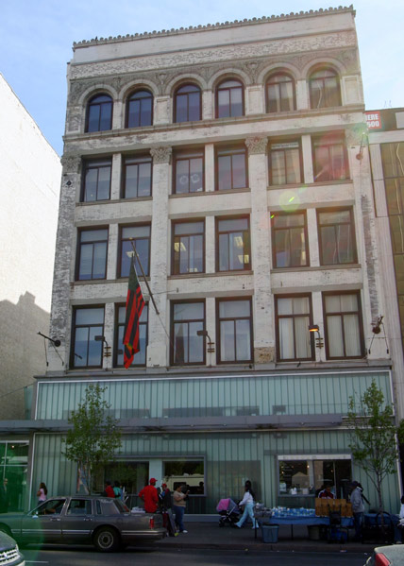
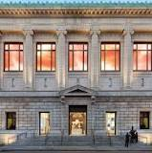
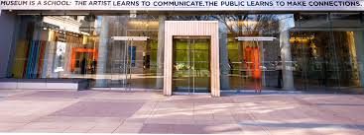
Founded 2010
J. Noble MD, C. Halpin-Healy
Mission
To improve quality of life for people with
dementia and their caregivers through
meaningful engagement with art
Partners
Studio Museum
N-YHS
The Met
El Museo

Slide 3
Need
People with Alzheimer’s disease
are living with problems of:
Attention
Language
Visual and spatial perception
Executive function
Memory
Glenn Ligon, Give us a Poem

Slide 4
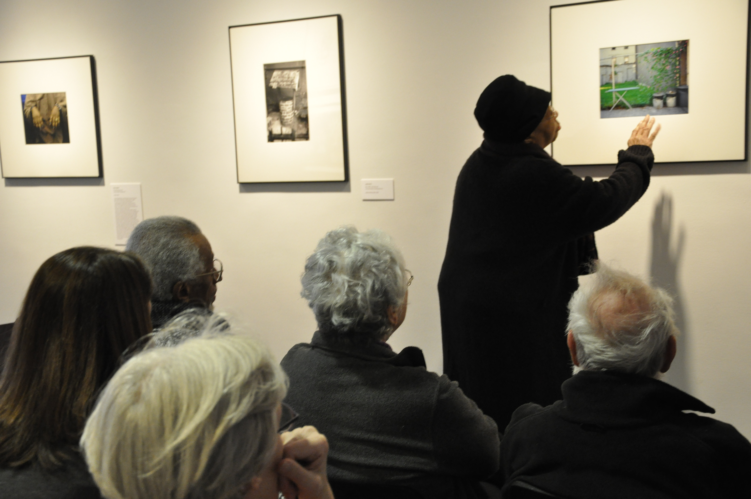
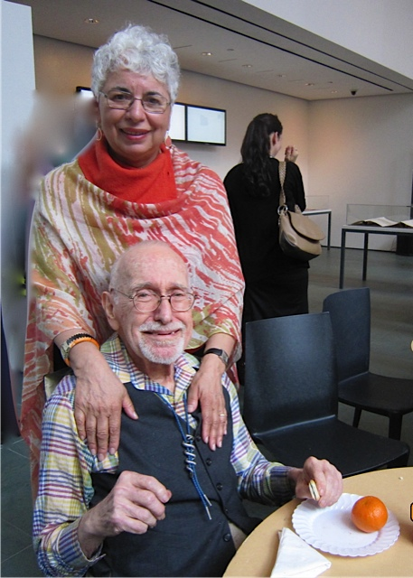
Program Goals
To provide opportunities for cognitive
physical and social stimulation by
connecting with art
We can say what we feel here
To reduce caregiver burden, isolation and stress
by fostering comfort at the Museum and communication through shared experiences with works of art

Slide 5
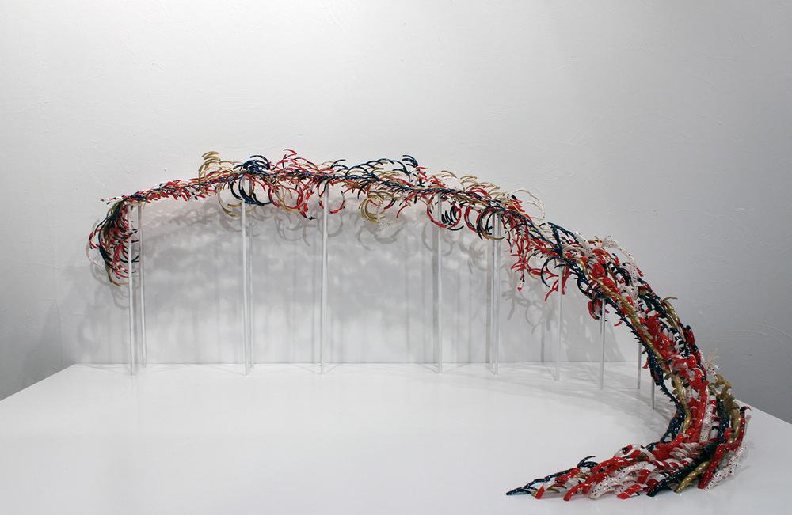
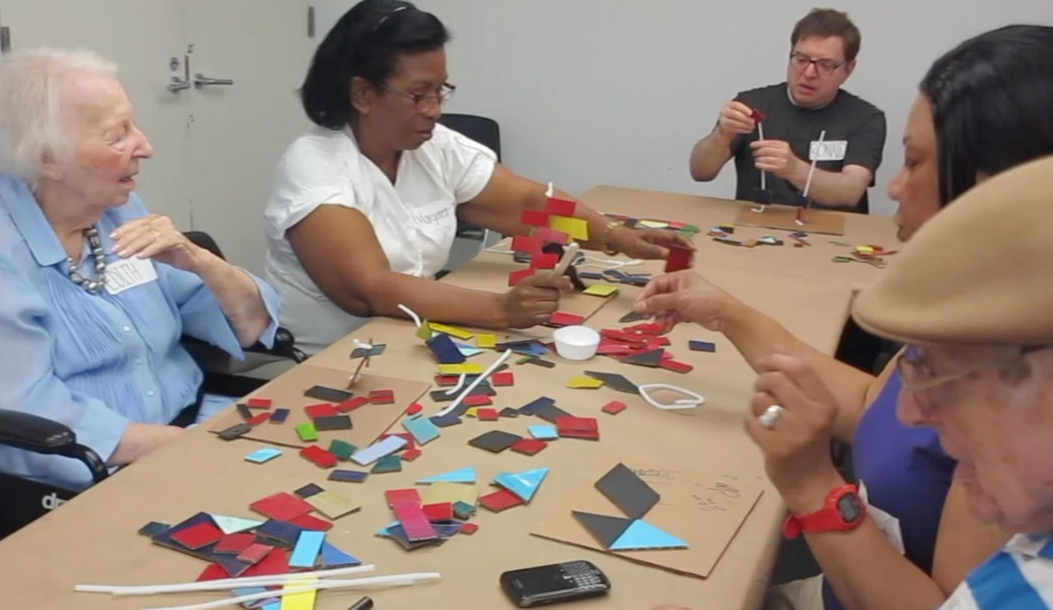
Structure
1.
Response & Interpretation
2.
Creative Expression
Pamela Council, Flo Jo World Record Nails
It’s something other. It makes you want to get up and go.
-participant with severe word-finding difficulty

Slide 6
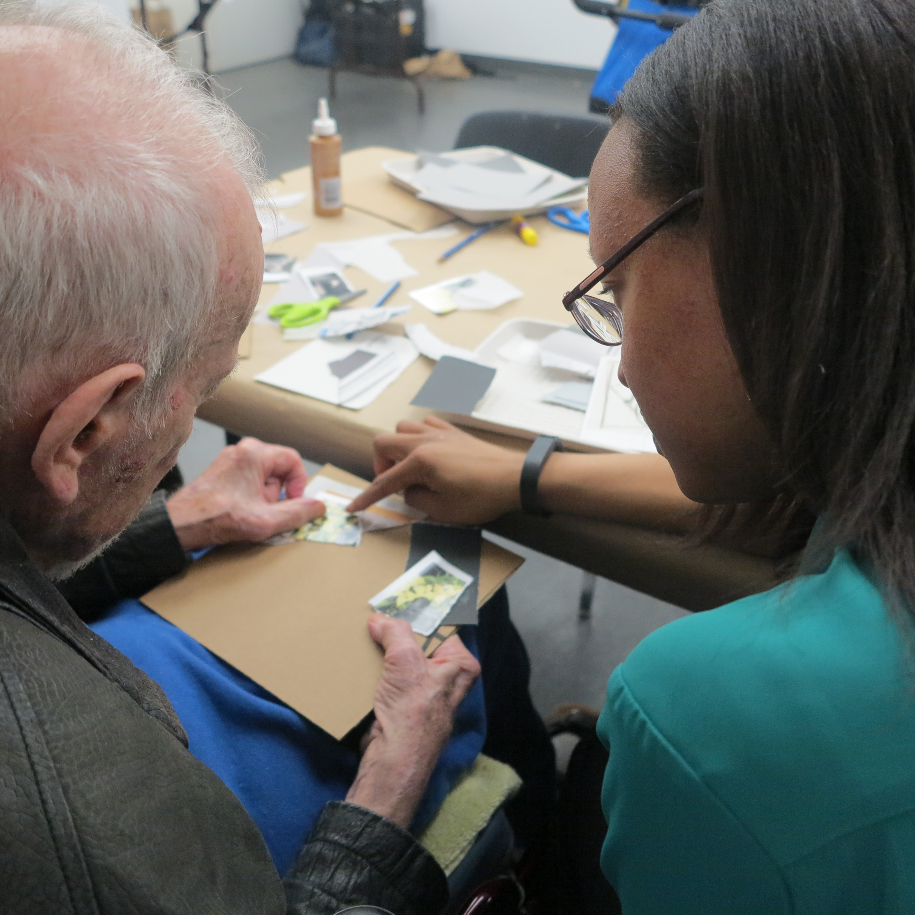
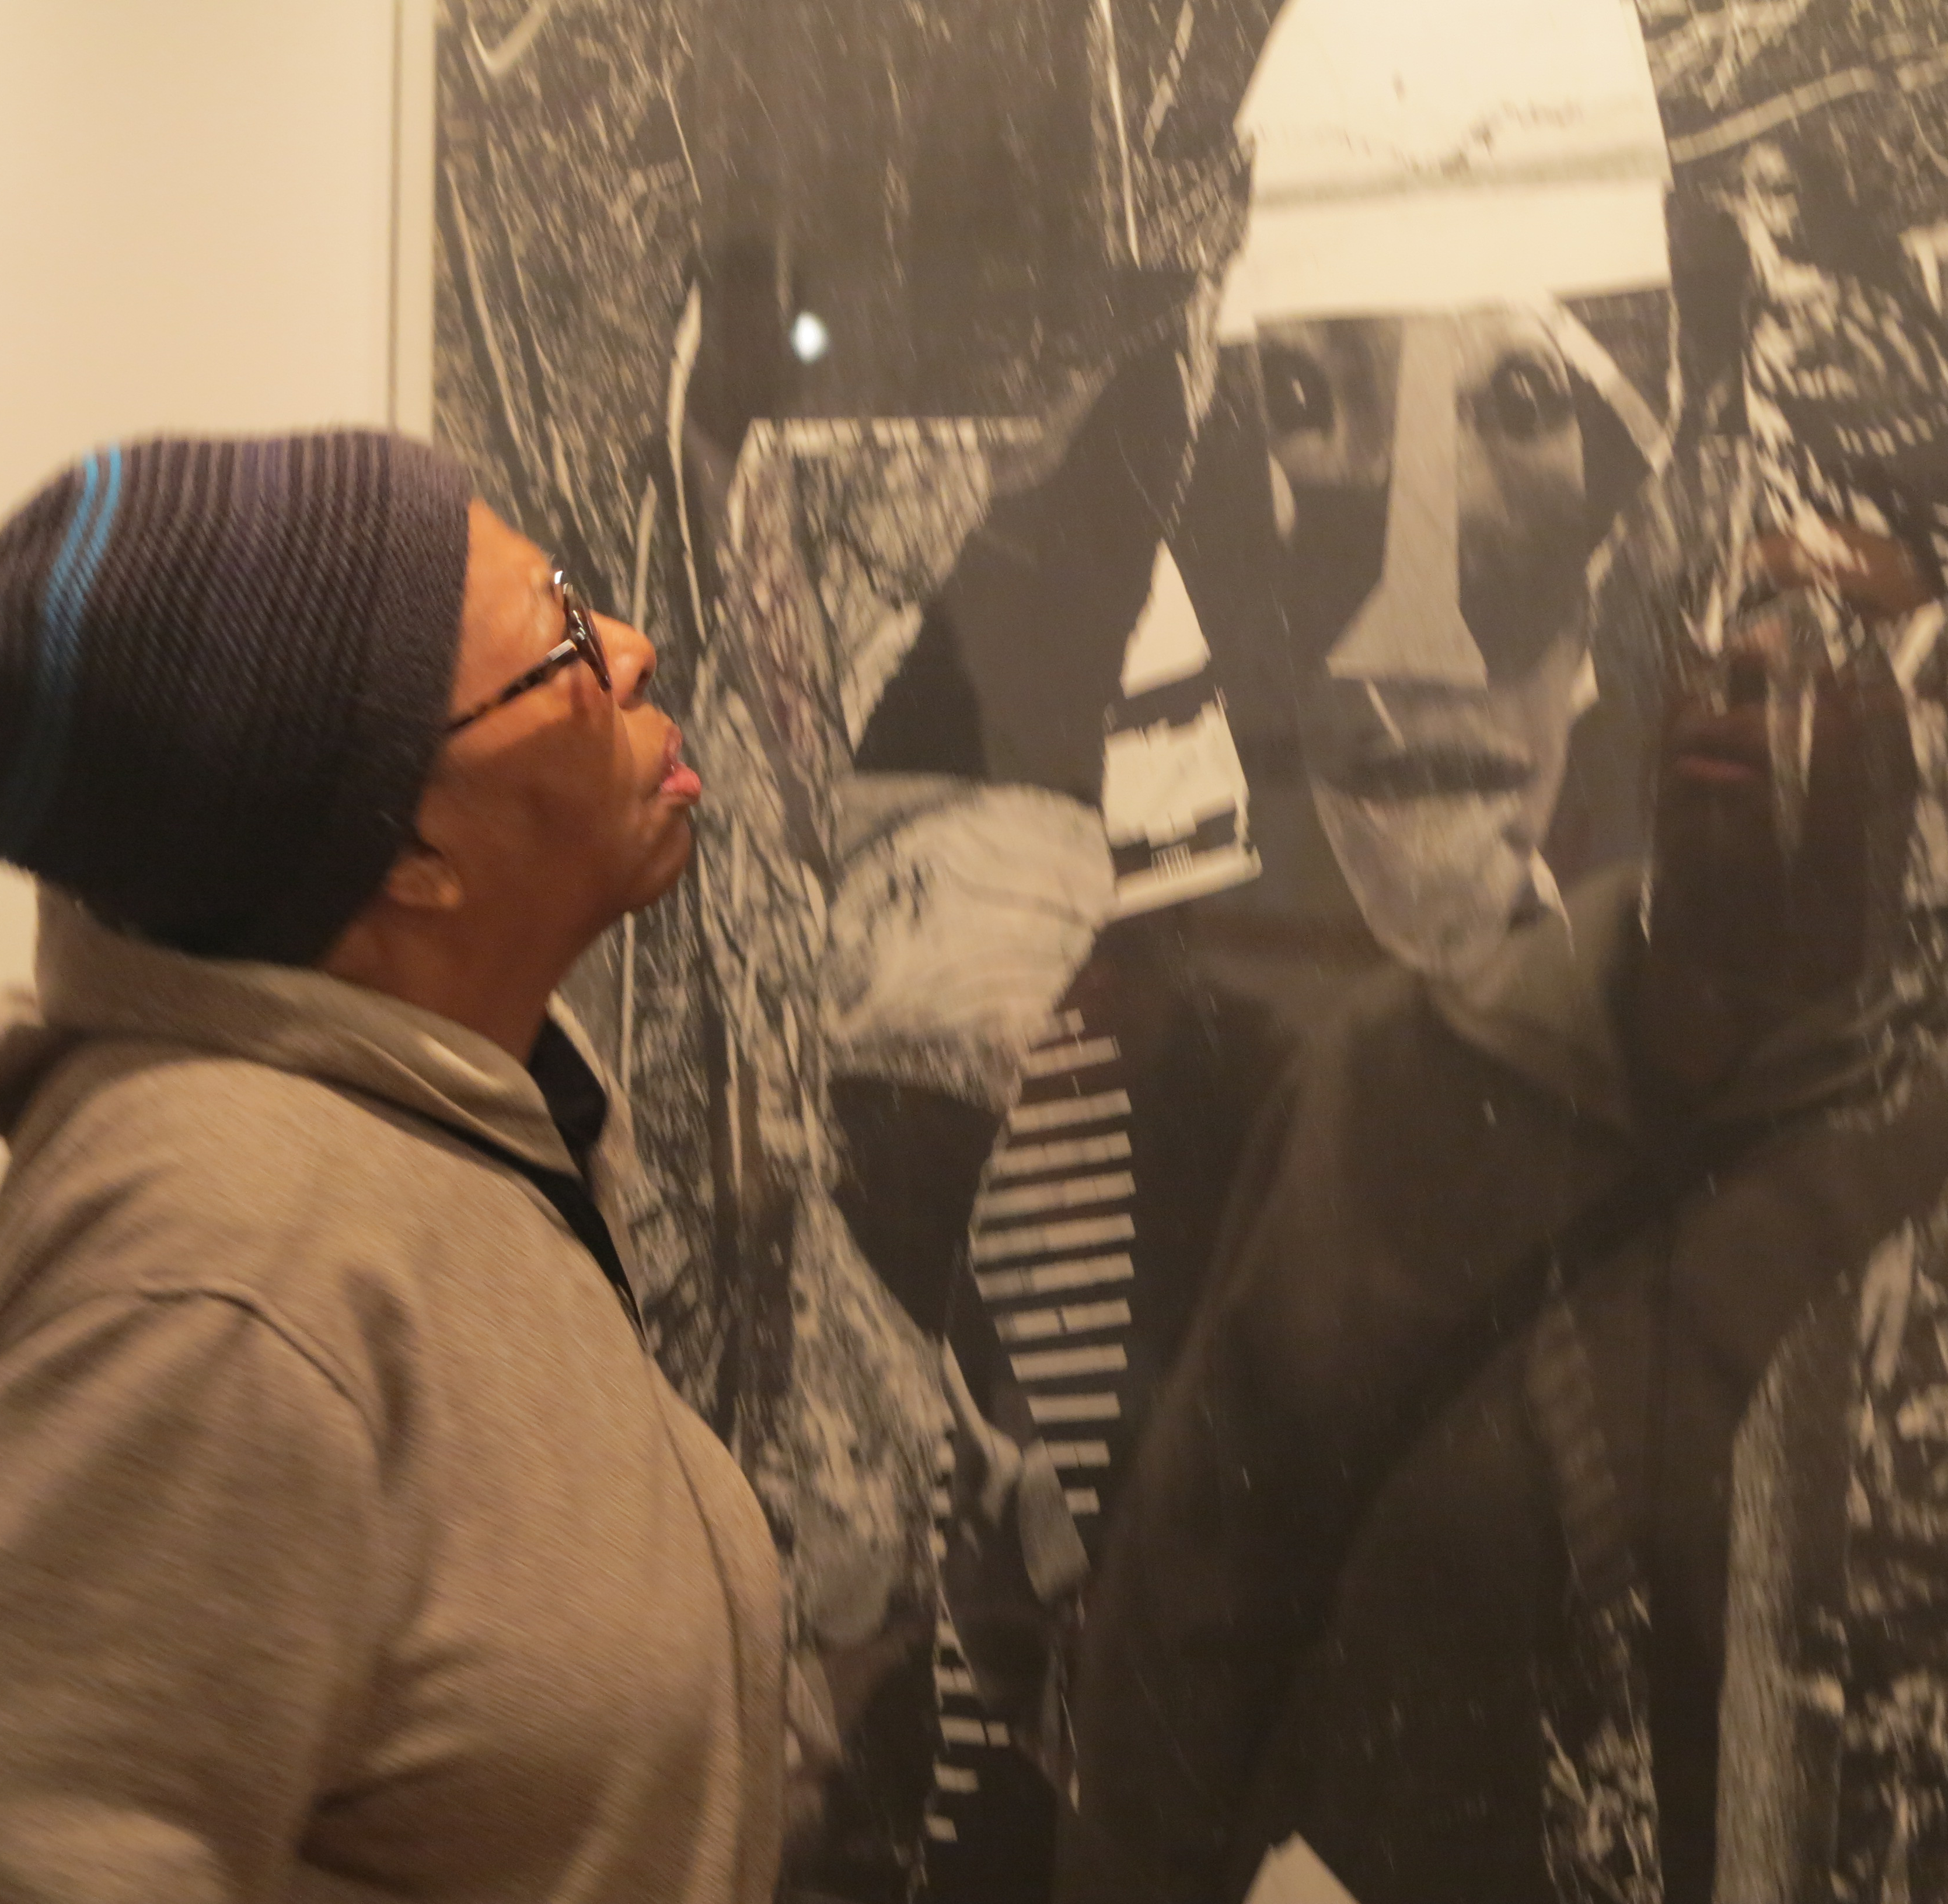
Impact
Individuals with dementia
Caregivers
Improve Mood
Reduce Apathy
Improved Cognitive Function (perceived)
Improve Mood
Reduce Stress and Isolation

Slide 7
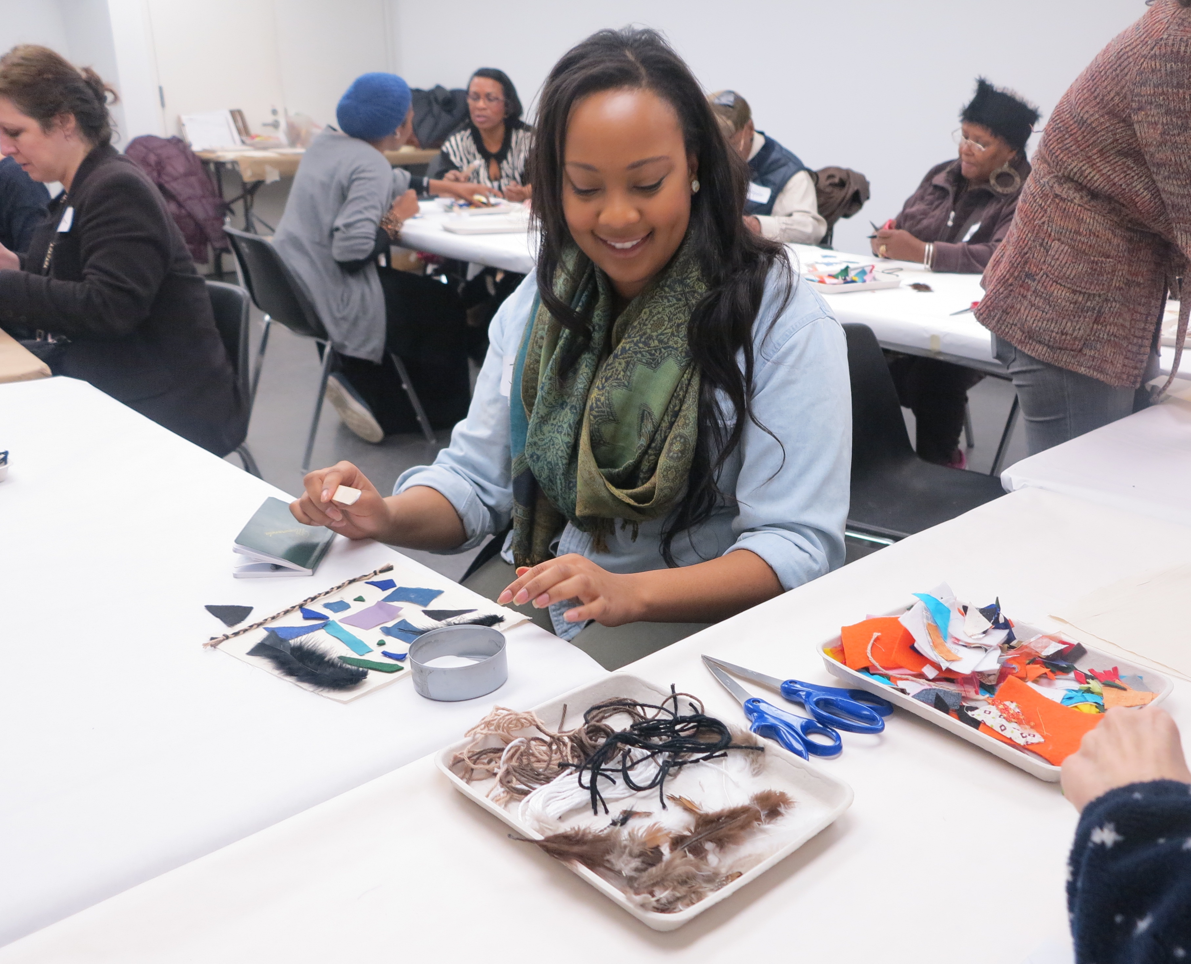
Impact
Medical Students
Museums
Gains in favorable dementia attitudes
Formative experience for young adults
Museums as spaces of social inclusion
Supports mission
Improves organizational pride
Mitigates fear and stigma

Slide 8
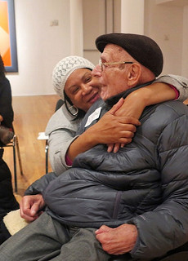
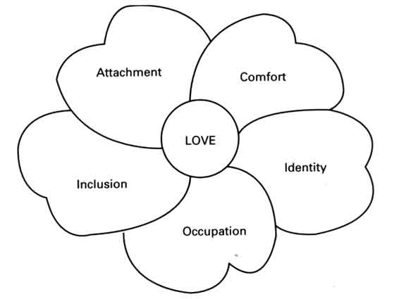
Solidarity between museums and participants
Art

Slide 9
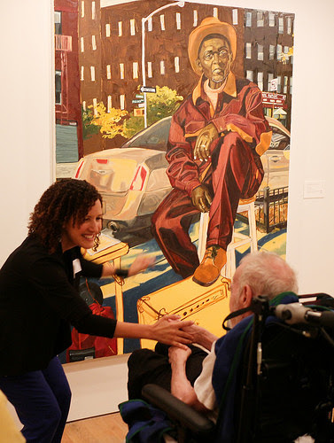
Unconditional
Positive
Regard
Meaning
Making
➔
➔

